Slide 1

Bach’s Uncanny Intuition
Eric Keller, Prof. hon. emeritus,
Université de Lausanne

Slide 2
Résumé
A numerical test of the Circumplex Model in Bach’s teaching corpus.
02
Novel tendencies were identified for happiness, sadness and anger in Bach’s corpus.
03
From J.S. Bach examples to a modern theory of emotion and vocal expression, the Circumplex Model.
01

Slide 3
Reflections
John Sebastian Bach wrote two different types of music.
On the one hand, he composed many exceptional pieces of music, typical of his time period. His compositions are numerous (tot. 1128), as were the various types of music that he presented.
On the other hand, he also wrote some short pieces which appeared to be ordered. Toward the end of his life he was teaching in a prestigious live-in choir in Leipzig. He may have produced these compositions just for this teaching task.
I analyzed this teaching corpus, particularly for its emotional motifs.

Slide 4
Bach's teaching corpus
Components:
Two-part Inventions
15 melodies, each about 2 lines long, for 1-2 minutes
Three-part Inventions
15 melodies, each about 3 lines long, for 3-5 minutes
Well-tempered Clavier, first and second elements
24 melodies, containing two sections each
Each melody is written on about two lines, each for 2-4 minutes
Examples are given below.

Slide 5

From heard discovery to emotional model
I listened to the 15 Two-part Inventions melodies, one after another.
They seemed to become sadder and sadder.
The melodies started with the happiest example, each seemed a bit less "enthusiastic", and by the 15th we reached the saddest example.
Happiness
Sadness
I had conversed about emotion in music with Branka Zei (Geneva).
We were both interested in this issue, she after many scientific studies about emotion in speech, and me, now curious about a series of emotional states of musical expression in John Sebastian Bach.
She sent me a stack of studies about emotion in speech. I was struck by one study, issuing from an IBM research group in San Jose in California.¹
It argued that “the majority of emotions can be best explained in terms of the arousal and valence divisions using the two-dimensional model,”
the Circumplex Model.
¹ Seemo: A Computational Approach to See Emotions, Zhe Liu, Anbang Xu, Yufan Guo, Jalal U. Mahmud, Haibin Liu, Rama Akkiraju IBM Research - Almaden San Jose, CA, USA, April 2018.

Slide 6
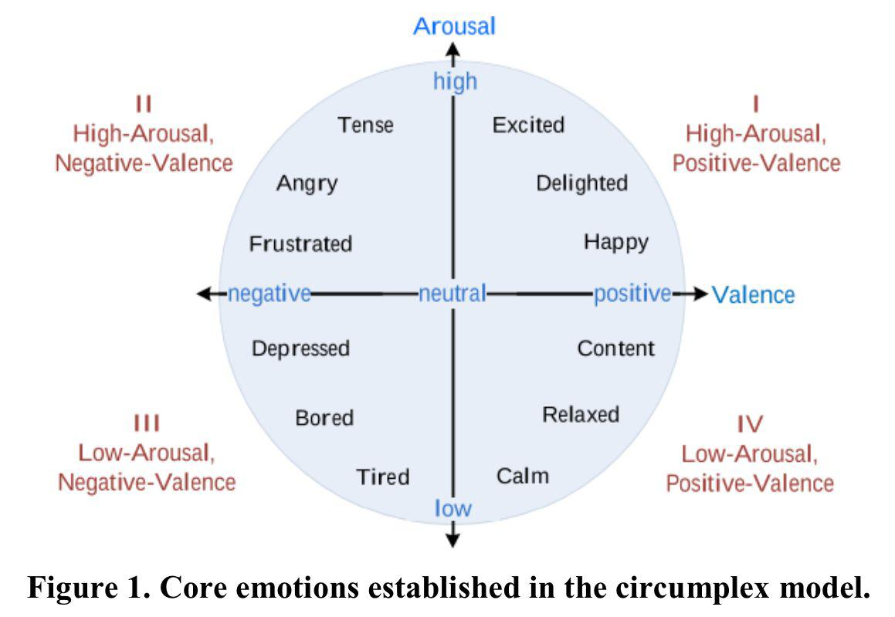
The Circumplex Model
ArousaI, high – low, in blue
Valence, left – right, in blue
In any speech or music sample…
Identify happiness [vs. sadness] - vertical
Identify anger [vs. fear] - vertical
Estimate its positivity or negativity - horizontal
In music, like speech…
Music can evoke happiness or sadness, and sometimes also anger or fear.
The valence parameter of “frustration” vs. “happiness” deals with the + or - strength and force in speech and may be found in Bach.

Slide 7
How to measure circumplex values
Branka Zei used an analysis package called "Vokaturi" that calculates key parameters of the Circumplex Model.
These parameters identify two vertical levels (happiness, sadness, anger and fear), as well as degree of positivity/negativity horizontally.
All one needs to do is to link a piece of speech or music to the analysis system, and out comes a numerical estimation of the degree of happiness, sadness, anger and fear as well as the degree of positivity/negativity.
Could all this apply to music?
I got a license to Vokaturi myself, tried it, and what came out?
The initial melody showed a general tendency from more to less “happiness”.
https://vokaturi.com/

Slide 8
“Happy” to “sad” in Two-part Inventions
“Happy”
No. 1
“Sad”
No. 15

Slide 9
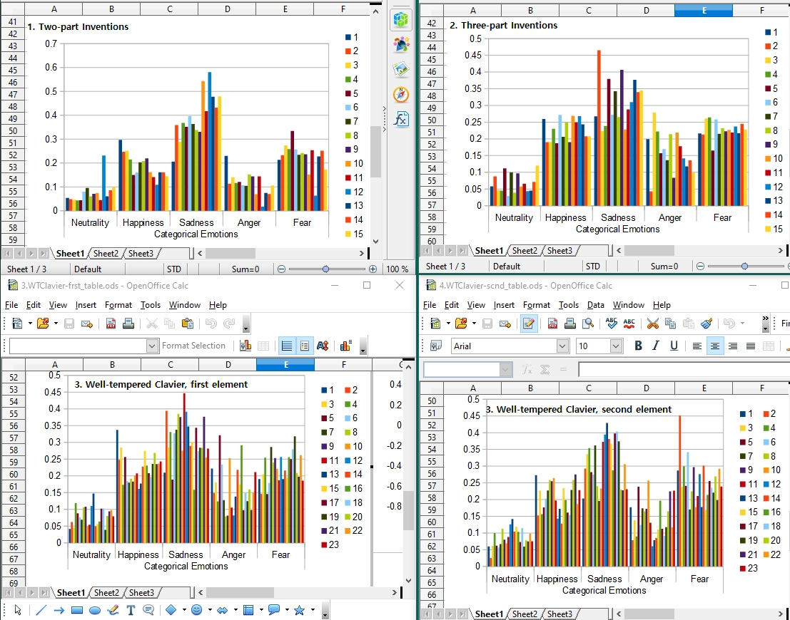
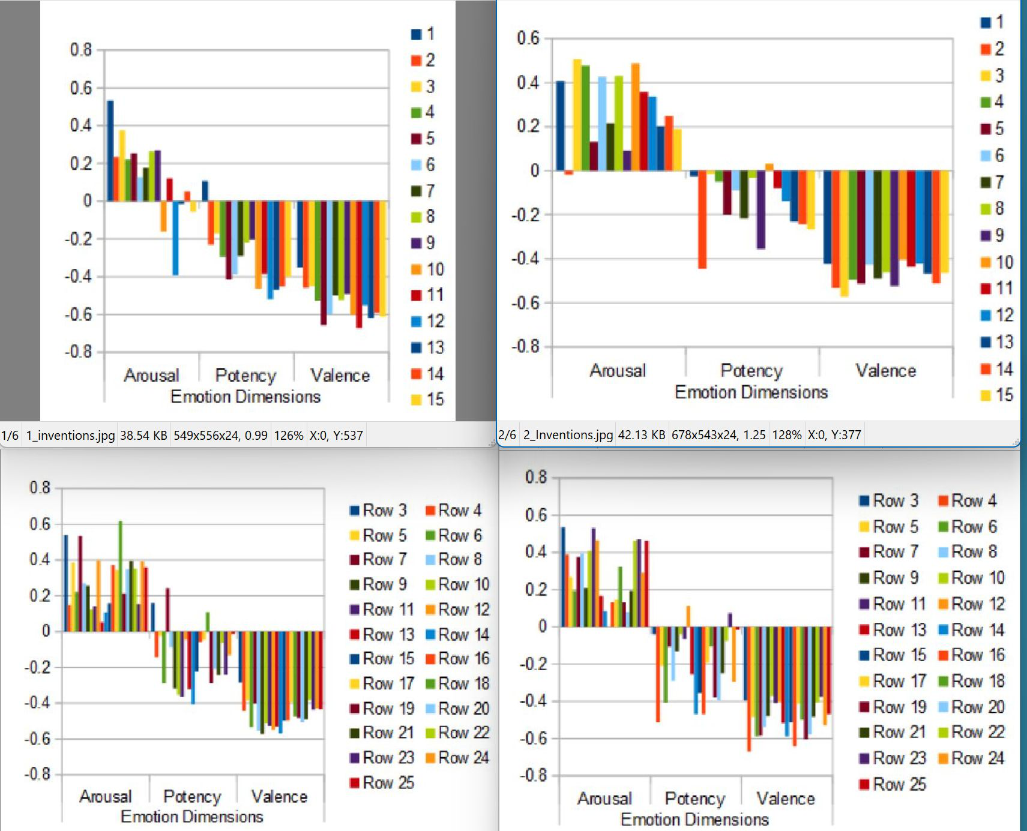
All measures of this study
Arousal
Near 4 sites
Positivity
Far 4 sites
I found relevant values only in the Arousal sites.
Results from the Positivity sites were non-significant.

Slide 10
“Sadness” gave the strongest Vokaturi results
All conditions (Two-part Inventions, Three-part Inventions, Well-tempered Clavier, first and second) provided similar results.
In red are the strongest Vokaturi results.
Two Part Inventions
initial no. 15/15
Three Part Inventions
initial no. 2/15
The Well Tempered Clavier, first melody
initial no. 11/24
The Well Tempered Clavier, second melody
initial no. 13/24
The strongest reaction favored unusual conditions every time.
In TwoPartInventions_15 was unusually slow and highly marked.
In ThreePartInventions_2, the speed is less than normal to emphasize the distinction.
In Well Tempered Clavier 1 a rising or a strong-weak syncopation can be heard.
In Well Tempered Clavier 2, complex patterns are illustrated.
Bach showed that every further step in the melody increased its complexity.

Slide 11
Second-strong melodies: “Fear”
We analyzed all events that were second-strongest in the Vokaturi results. In every one of the four conditions (Two-part Inventions, Three-part Inventions, Well-tempered Clavier, first and second) we found the second strongest example that indicated Fear.
This permitted the following melodies to manifest:
Two PartInventions 5/15
Three PartInventions 4/15
The Well Tempered Clavier, first 19/24
The Well Tempered Clavier, second 2/24
Three of these four conditions are rapid and threatening.
Threatening is best illustrated with this: The Well Tempered Clavier, second 2/24

Slide 12
Anger results: No perceptible effects
Finally I analyzed events that showed weak characteristics. In this weak group, I again selected the strongest examples.
But to my ears, these examples did not seem exceptional in any sense.
Examples of “strong” in the weak group:
Two Part Inventions 1/15
Three Part Inventions 3/15
The Well Tempered Clavier, first 5/24
The Well Tempered Clavier, second 10/24
In the Vokaturi measures, no distinctive pattern emerged for anger results.

Slide 13
Overall results
Here are the novel tendencies that we identified in J.S. Bach's teaching corpus:
Happiness: Melody sequences show a multi-step degradation from happy to sad.
Sadness:
In the first condition, we hear unusually slow and strongly marked melodies.
In the second condition, the melody is similar but it is rising or emphatic.
In the third condition, a strong-weak syncopation is heard.
In the fourth condition, complex patterns are illustrated.
Anger: Three of the four conditions are exceptionally rapid and tend to evoke threatening.
This Vokaturi examination has documented a systematic use of certain distinctions by J.S. Bach.
Furthermore, a number of J.S. Bach's previously unsuspected interests have been brought to the fore in this study.

Slide 14
Résumé
John Sebastian Bach wrote two different types of music. On the one hand, he wrote many exceptional pieces of "general music". His compositions are numerous (tot. 1128), as was also the grand variety of music that he presented.
On the other hand, he wrote certain short pieces that seemed to be ordered somehow. Toward the end of his life he had supervisory and teaching in a prestigious live-in choir in Leipzig. It was likely that this last section of his life, he authored these music pieces.
We wished to study J.S. Bach's emotional composition as it was reflected in this teaching corpus. An IBM research group in San Jose in California argued that “the majority of emotions can be best explained in terms of the arousal and valence divisions using the two-dimensional model”, i.e. the Circumplex Model.
An analysis package called "Vokaturi" calculates the parameters of the Circumplex Model¹. This package² permits to identify four main levels (happiness, sadness, anger and fear) in any speech or music data base. I linked Bach's melodies to this analysis system, and a numerical estimation of the degree of happiness, sadness, anger and fear were produced.
The following are the tendencies that we identified in J.S. Bach's teaching corpus:
Happiness: His melody sequences show a multi-step degradation from happiness to sad. Sadness: In the initial set, unusually slow and highly marked melodies are in evidence, in the second condition, his enunciation is rising or emphatic, in the third condition, strong-weak syncopations are heard, and in the final sequence, a complex pattern is presented. Anger: Three of the four conditions are exceptionally rapid and threatening.
We conclude that the Vokaturi examination has documented a systematic use of certain distinctions by J.S. Bach. Furthermore, a number of J.S. Bach's previously unsuspected interests have been brought to the fore in this study.
¹ Seemo: A Computational Approach to See Emotions. Conference Paper · April 2018
² https://vokaturi.com/

Slide 15
My Encore
Thirty original compositions.
https://www.neoclassix.info.
02
Example: Eric Keller’s Version of “Blind Mary”
03
New sounds:
Change to classical music.
01

Slide 16

Sound connects us. Sounds give us meaning. Sounds can also heal us.
What joy it is to discover life in the world of sounds!
images/Intricate-Oscillation/208441484
Adobe.com

Slide 17
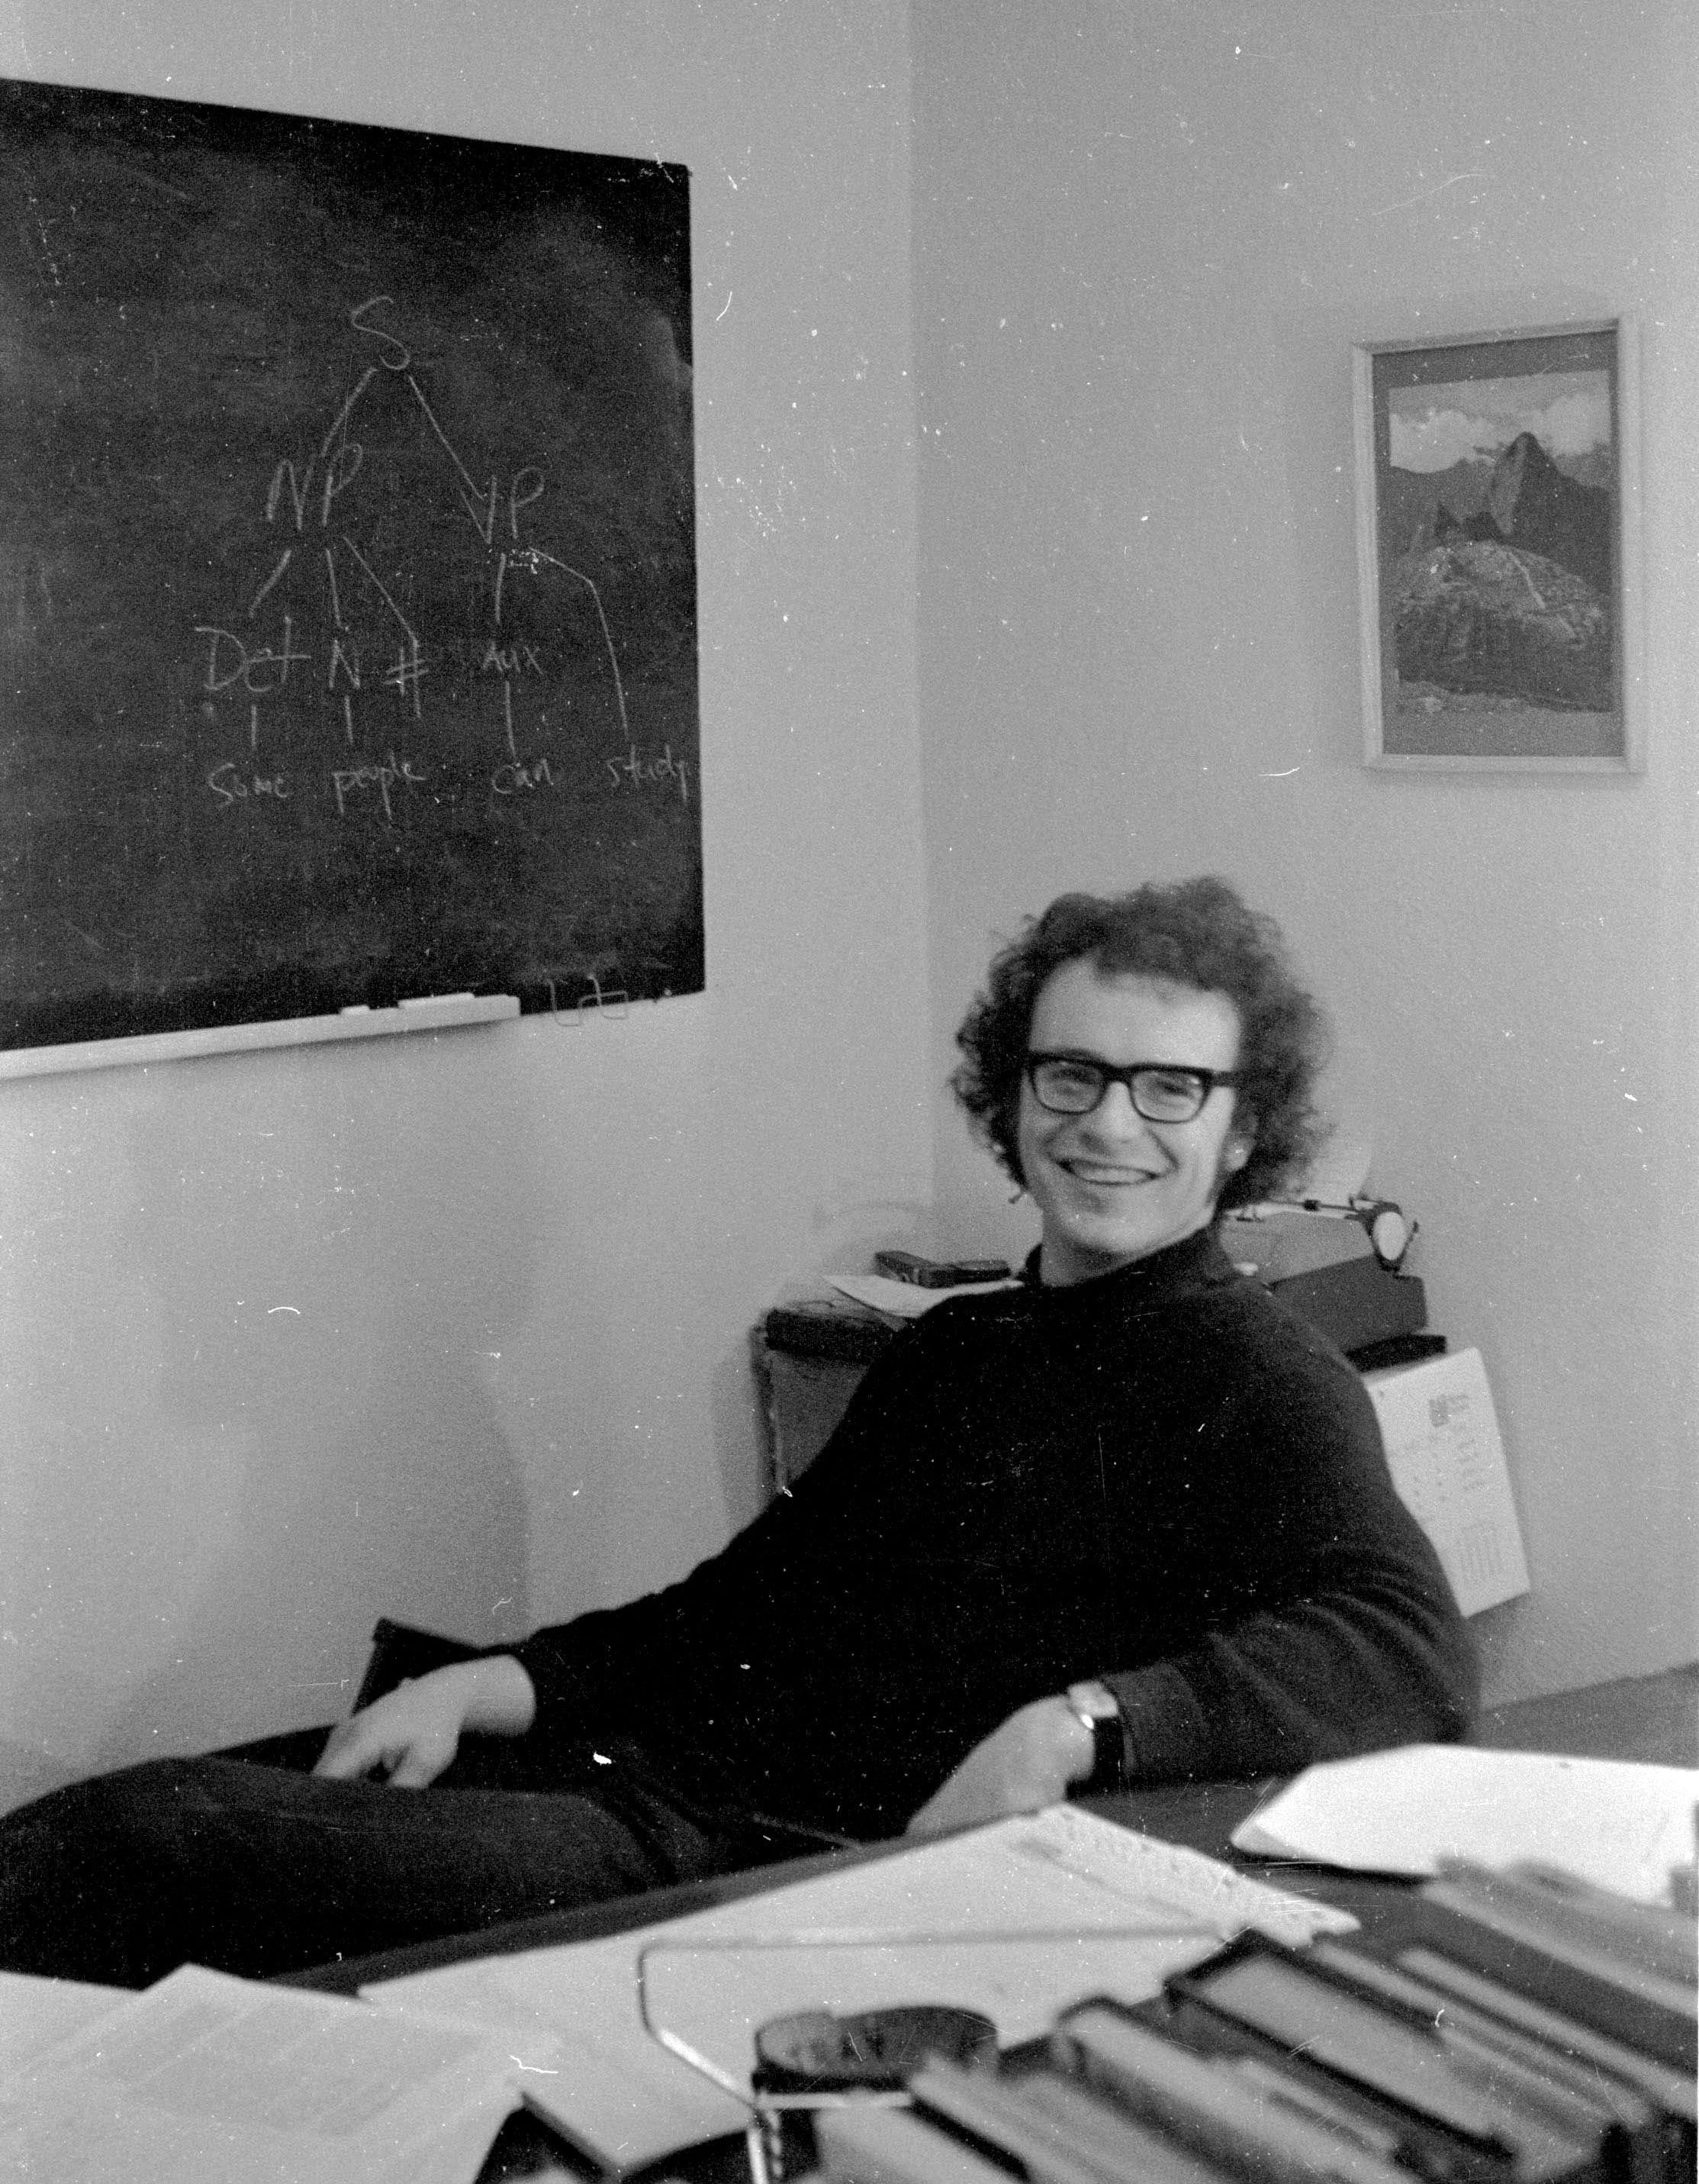
What after retirement?
1972 - Notice “NP + VP” on board
Sounds studies before retirement
In a PhD program at the University of Toronto, learning about speech, articulation, articulatory deficits and aphasia, beginning in the 1970s
Member of the psycholinguistics team, UQAM | Université du Québec à Montréal 1978-1991
Many publications about speech, Université de Lausanne,1991-2008 https://www.erickeller.ch/Kellerdoc.html
Sounds studies after retirement
After 50 years in speech, I began to investigate classical music. https://www.neoclassix.info
Now we’re in 2025 and I am 80, and am still in the field of sounds.
After 10 years of classical music, more is to come…

Slide 18
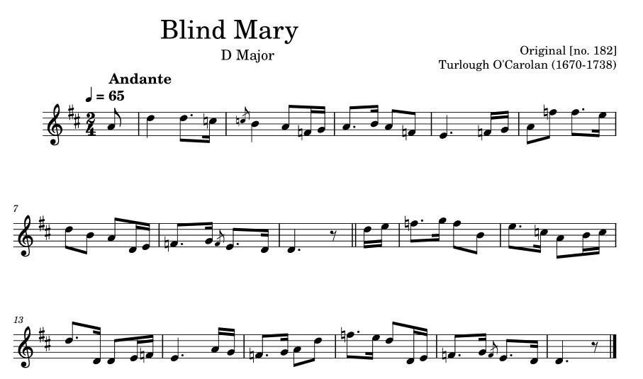
Original “Blind Mary”
How do composers develop their melodies?
I wanted to try composing.
Scores by Turlough O'Carolan were a good start.
Turlough O'Carolan was a blind Irish musician that lived from 1670 to 1738. His tunes were captured as short melodies, typically only one to two pages long.
I concentrated on thirty of these short tunes.
Here is one tune I worked on.
O'Sullivan, Donal (1958). Carolan: The life, times, and music of an Irish harper. London, UK: Routledge and Kegan Paul. No. 182, p. 127.

Slide 19
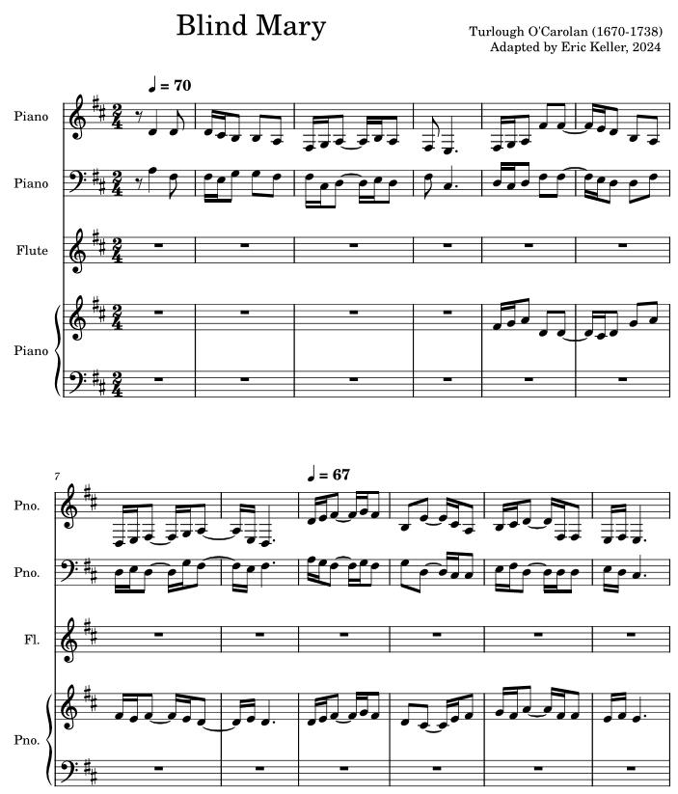
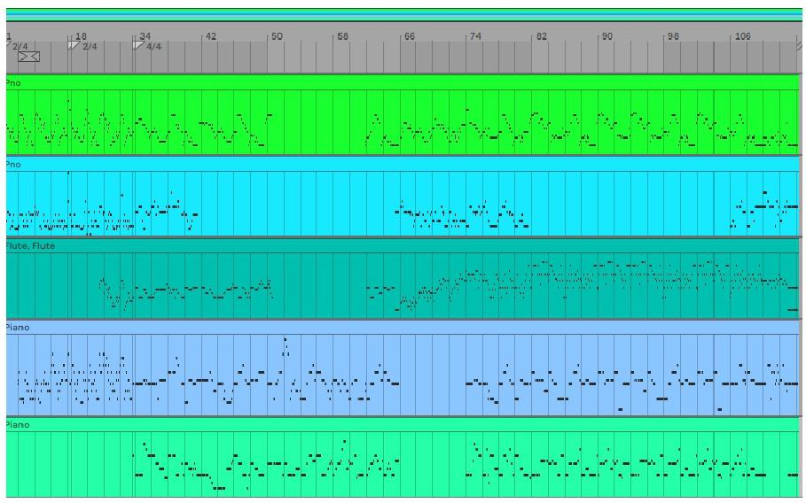
Eric’s Version of “Blind Mary”
Right out of the box, music sounded too rigid.
I used the techniques described here to smooth the auditory line: https://neoclassix.info/index.php/en/about-the-composer.
Final Version 3:27

